Slide 1

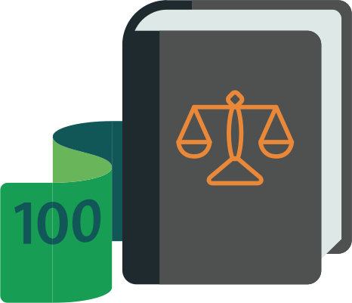
Financial Literacy Highlights and Clips
Let’s start!
Students and Laura will find out what we are talking about
Laura Piatti – Turin, 13 November 2023

Slide 2
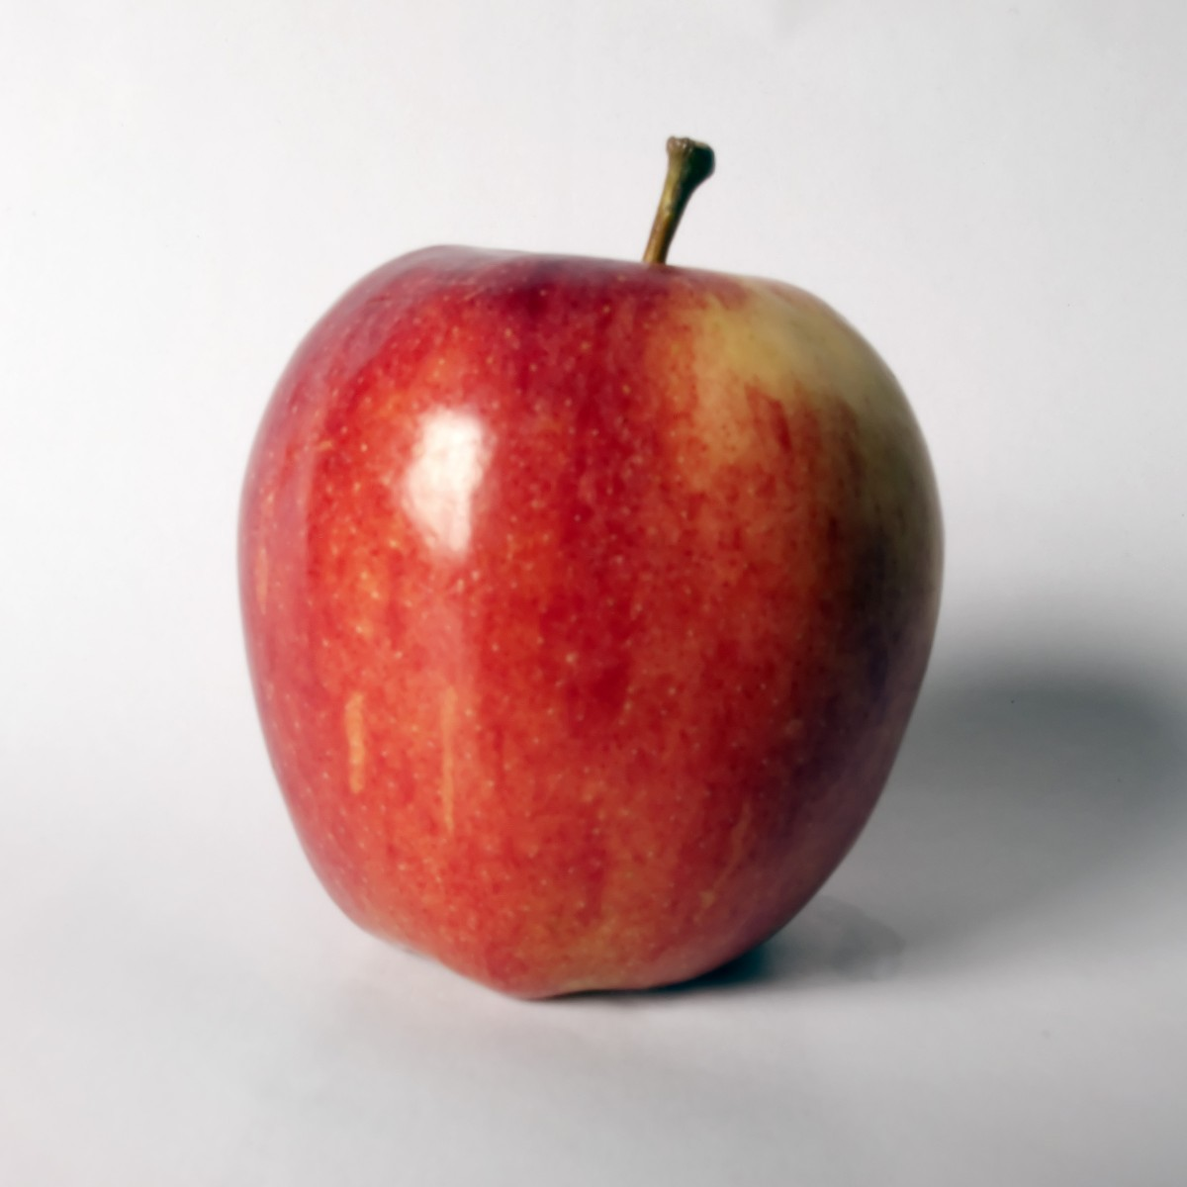
TAKE AN APPLE

Slide 3
THE APPLE - some KEYWORDS
Golden Apple
Red Delicious
Expensive
Bio
Unripe
Honeycrips
Rotten
Sour
Cheap
Mellow
Ripe

Slide 4
DEFINE AN APPLE
The fleshy, usually rounded red, yellow, or green edible pome fruit of a usually cultivated tree (genus Malus) of the rose family
RATE THE DEFINITION:
Easy to give and understand
Rather difficult to give but easy to understand
Difficult to give and to understand

Slide 5
THE APPLE
FIND OUT an APPLE, put it in front of you and try to describe the quality characteristics (you can touch it): does it seem like a healthy fruit? Quality of the fruit? Do you know if it is in season? Is it a harmful product for someone - children, the elderly, etc? How long can you keep it in the fridge or out of the fridge (postpone its consumption)? How much did you pay for it or are ready to pay? Do you consider the price fair? If you don't know if the price is fair, how do you evaluate it? Can you find out a way to evaluate the price without paying any cost?
How many different kind of apple available
        Value, price, cost of production
Value along time - LT value
Market
Comparison
Easy to evaluate the quality
Your knowledge

Slide 6
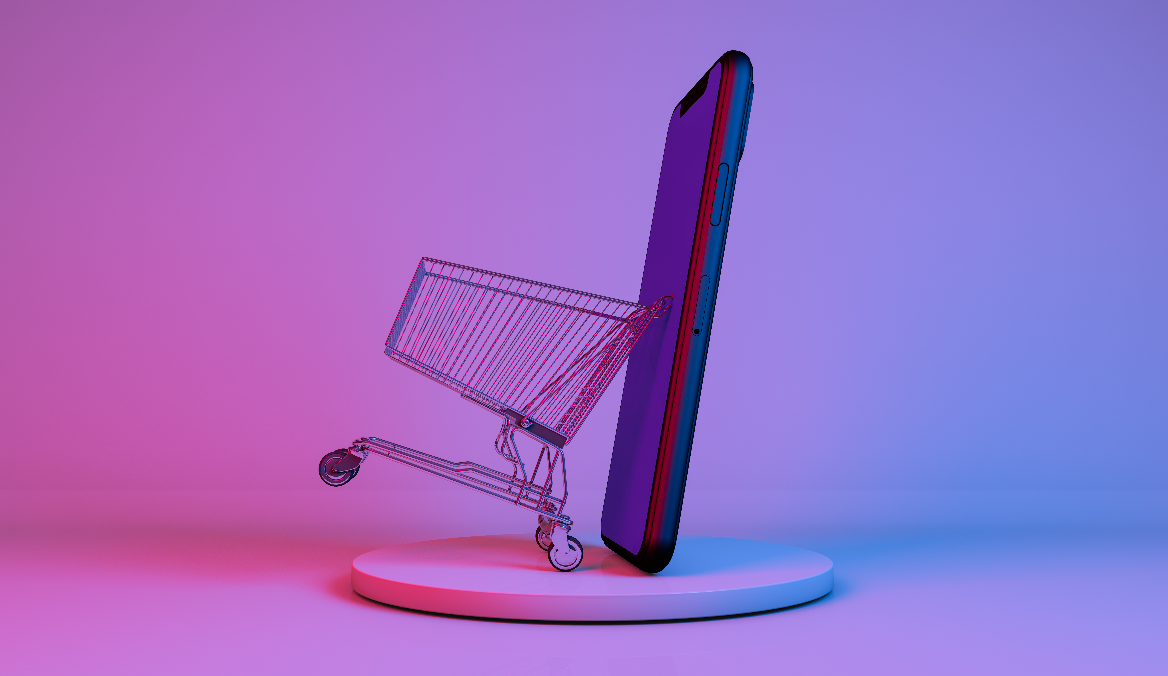
YOU’D LIKE TO BUY A MOBILE PHONE

Slide 7
MOBILE PHONE – some KEYWORDS
Flip phone
Iphone
Tim
Xiaomi
Samsung
CosmOTE
Refurbished
Oppo
Cricket phone
Vodafone
Wind
New
Used
3G, 4G, 5G
Processor
Free phones

Slide 8
DEFINE A MOBILE PHONE
A mobile phone is a wireless handheld device that allows users to make and receive calls. While the earliest generation of mobile phones could only make and receive calls, today’s mobile phones do a lot more, accommodating web browsers, games, cameras, video players and navigational systems.
Also, while mobile phones used to be mainly known as “cell phones” or cellular phones, today’s mobile phones are more commonly called “smartphones” because of all of the extra voice and data services that they offer.
RATE THE DEFINITION:
Easy to give and understand
Rather difficult to give but easy to understand
Difficult to give and to understand

Slide 9
The MOBILE PHONE
How many different kind available
Value, price, possible instalments payment, cost of production
Value along time - LT value
Market – new, used, refurbished
Comparison
Easy to evaluate the quality
Your knowledge
Does it work on its own? You need a traffic data provider for calls, internet, otherwise it is useless – unless you have a wifi at home - second service necessary

Slide 10
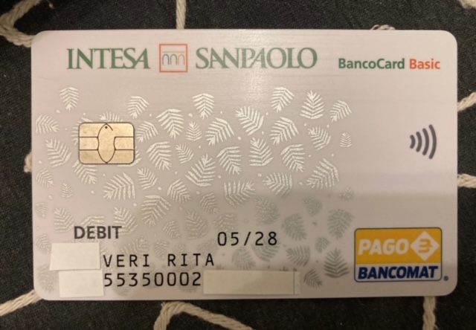
WHAT IS THIS?

Slide 11
MEANS OF PAYMENT – cards – some keywords
RUNNING FEES
FEES
CASH
Credit cost
Withdraw currency
Revolving card
overdrafts
Step up rate
balance

Slide 12
DEFINE MEANS OF PAYMENT: DEBIT, CREDIT, PRE-PAID, REVOLVING CARDS
Debit and credit cards both allow cardholders to obtain cash and make purchases.
Debit cards are linked to the user's bank account and limited by how much money is in there. With a debit card, you are spending money you have in your bank or credit union account.
Credit cards provide the user with a line of credit that they can borrow against as needed and pay back later; the user must have a bank account with a fixed, positive balance
Credit cards charge interest on the money the cardholder borrows (unless it's paid back within the grace period).

Slide 13
DEFINE MEANS OF PAYMENT: DEBIT, CREDIT, PRE-PAID, REVOLVING CARDS
A prepaid card is not linked to a bank account. Instead, you put money into the card account, sometimes called loading money onto the card, before you can spend it.
Generally, with prepaid cards and debit cards, you can’t spend more than you have loaded on the card or than you have in your account. If you try to spend more, the transaction is denied.
However, some bank allow you to make overdrafts, and so do some prepaid cards. Overdrafts allow you to overspend, and then you must replace the money. Plus, you have to pay an overdraft fee for each transaction that overdraws your account (so-called revolving cards).
RATE THE DEFINITION:
Easy to give and understand
Rather difficult to give but easy to understand
Difficult to give and to understand

Slide 14
MEANS OF PAYMENT: DEBIT, CREDIT, PRE-PAID, REVOLVING CARDS
How many different means of payment available
Credit, debit, pre-paid, revolving
Value, price, cost, running fees
Value along time - LT value
Market
Comparison
Easy to evaluate the quality
Your knowledge - documents provided by the bank in order to show cost, fee, cap, limit
Does it work on its own? You need a bank account and money on it – deposit –

Slide 15

The local market apple, the mobile phone, the credit cards are…
Tangible or untangible
Full information or incomplete information
Transparency or opacity
IN ORDER TO CHOOSE THE BEST OF THEM, YOU NEED SOME KNOWLEDGE… OR YOU NEED TO KNOW THE QUESTIONS TO ASKED
HOW MUCH KNOWLEDGE? AND WHY?

Slide 16

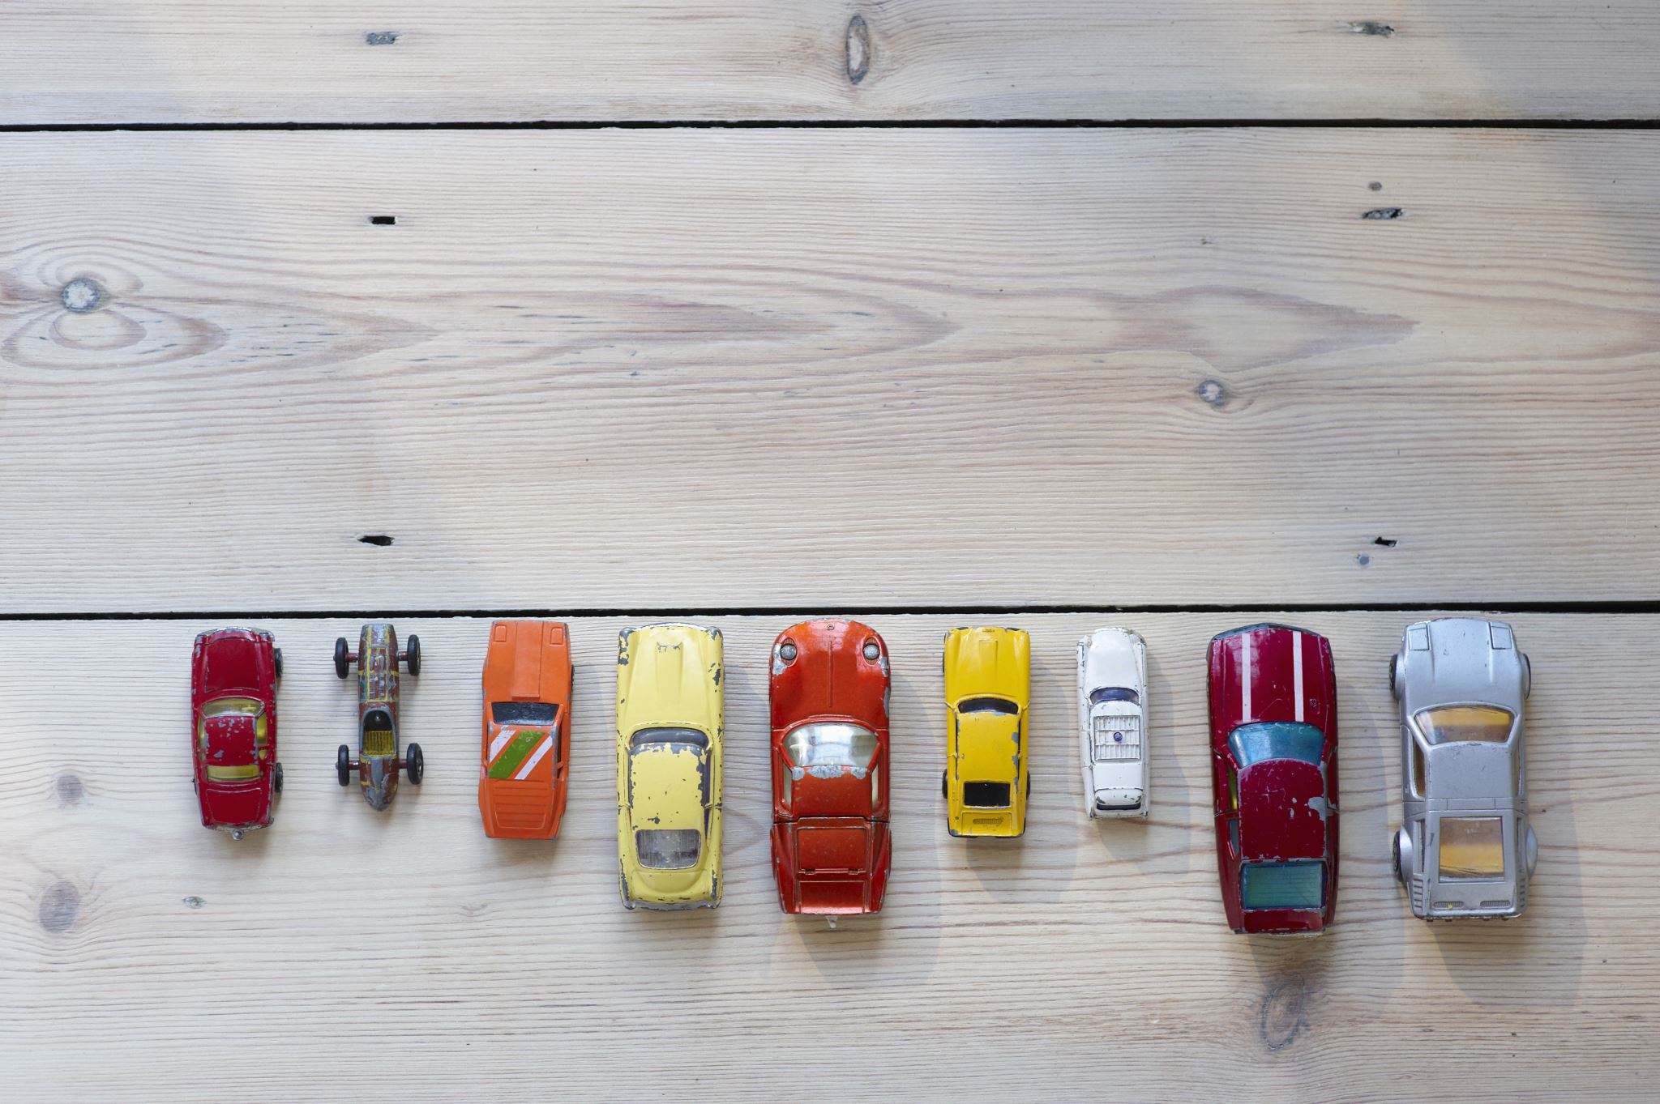
The power of CHOICES
Choice, in philosophy, is the supposed ability to freely decide between alternatives. Choice is a corollary of the traditional notion of free will, understood as the supposed power or capacity of humans to make decisions or perform actions independently of any prior event in, constraint or state of the universe.
Life choices are the decisions we make in life that will affect our future and determine our path. Life choices can be anything from the type of career we choose, who we decide to build relationships with, how we spend our money, and the values and beliefs we choose to live by

Slide 17
The power of CHOICES
One right choice could change your future. Through the choices you make, you can unleash your incredible human potential. Your choices today determine your tomorrow. You must be aware of your choices and, before choosing, getting the relevant information about the different options
Overall, freedom of choice is an important aspect
of individual liberty and allows individuals
to make decisions that align with
their own beliefs, needs, desires

Slide 18
Choosing the local market apple, the mobile phone, the credit cards… the same process, but…
CHOOSING AND APPLE
HOW MUCH KNOWLEDGE
WHY
QUESTIONS TO ASK
CHOOSING A CREDIT DEBIT OR PREPAID CARD
HOW MUCH KNOWLEDGE
WHY
QUESTIONS TO ASK
CHOOSING A MOBILE PHONE
HOW MUCH KNOWLEDGE
WHY
QUESTIONS TO ASK
THE ROLE OF TRUST

Slide 19

ECONOMIC CHOICES
Economics is all about choices. People are faced with choices every day. Should we walk to school or take the bus? What should we eat for lunch? Similarly, businesses also need to make choices, such as what products or services they will provide, while governments need to decide how to spend taxpayers’ money.
When investigating each of these choices the potential consequences that will affect society need to be addressed. Whatever choice people, businesses or governments take, they will miss out on the alternatives they did not choose. As economists, we look at how to choose the alternative that will bring the greatest benefits as well as the consequences of the actions we choose to make.

Slide 20
ECONOMIC CHOICES
Sometimes we feel pressure from our peers to buy a product. If everybody else has the latest smartphone and we don’t, we might feel like a social outcast. Without these pressures, we would be less likely to buy the product. This would allow us to consider spending our money on something else that may bring us more satisfaction. For example, we could have saved our money for a rainy day, or even donated it to those in need. Whatever you decide to do with your money, make sure that it is a rational decision that is most likely to give you the greatest satisfaction in the long run.

Slide 21

MEANS OF PAYMENT AND FINANCIAL INSTRUMENTS – ECONOMIC CHOICES
Financial instruments are monetary contracts between parties. They can be created, traded, modified and settled. They can be cash (currency, BANK DEPOSIT), evidence of an ownership interest in an entity or a contractual right to receive or deliver in the form of currency (forex); debt (bonds, loans); equity (shares); or derivatives (options, futures, forwards).
For example, a person who has already acquired a house, food, water, basic clothing, and has money left over will buy an item that will make their life easier, such as a car. That person may later decide to buy a phone, a bag, designer jeans, a new car, a new smartphone and the list goes on.

Slide 22
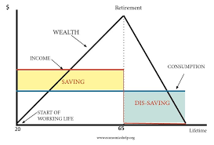
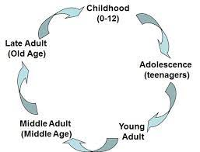
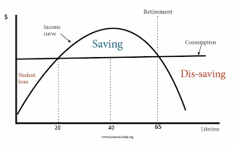
THE LIFE CYCLE MODEL

Slide 23
CHOICES and life cycle
Economic and Financial Literacy is basic knowledge possibly to be acquired early in life to make individual financial decisions better informed and more effective. This applies particularly to decisions that have long term consequences

Slide 24
BASIC CONCEPTS
SAVING
INCOME
WEALTH
CONSUMPTION
INVESTING YOUR SAVING ON FINANCIAL MARKETS

Slide 25
BASIC CONCEPTS
DISCOUNT RATE
LOANS
MORGADGE
SHARES
BONDS
DERIVATIVES

Slide 26

Ubuntu! Laura Piatti

