Slide 1
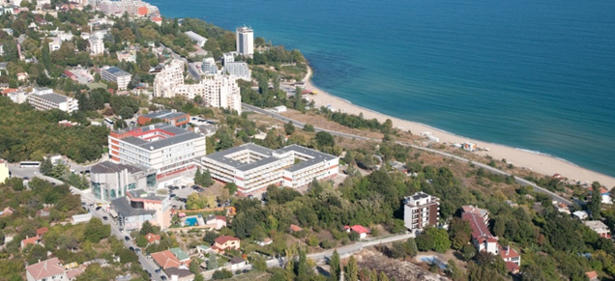
FINANCIAL LITERACY FOR THE ECONOMIC
DEVELOPMENT OF SOCIETY
№2022-1-BG01-KA220-SCH-000087865
Key Action 2: Cooperation among organisations and institutions
KA220-SCH - Cooperation partnerships in school education
LEARN AND SEARCH
Kick-off meeting in Varna, Bulgaria 29th - 31th May 2023
Prof. Emil Panusheff, PhD
VarnaFreeUniversity www.vfu.bg

Slide 2
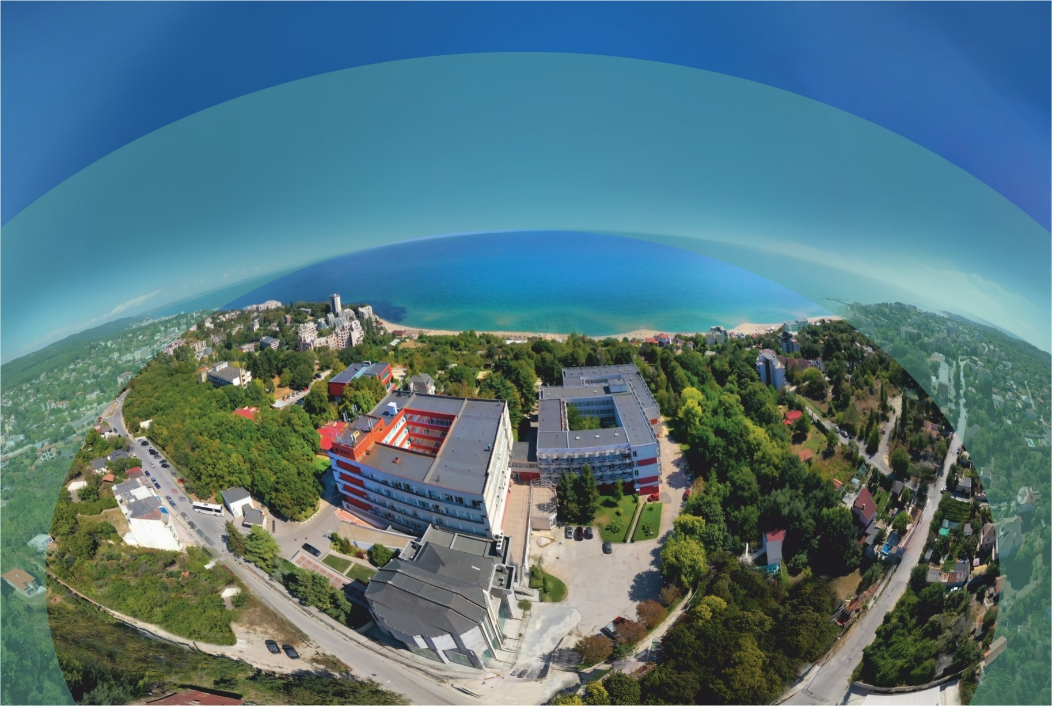
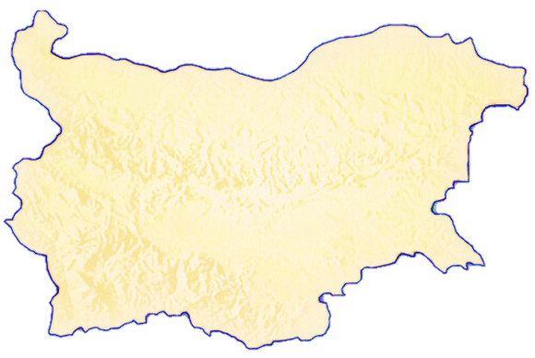
Attractive educational destination
Varna Free University is one of the largest private universities in Bulgaria with over 30 years of history
Located 12 km from Varna in the vicinity of beaches and Golden Sands nature park
Facilities:
Modern university campus
Specialized laboratories and halls
Institute of Technology
400-seat concert hall and sports hall
Library with 116,000 library items
Beautiful park with an open-air stage
Dormitory, cafe, restaurant, parking lot
Convenient public transport, offering discount cards, runs to the university
Varna
Sofia
VarnaFreeUniversity www.vfu.bg

Slide 3
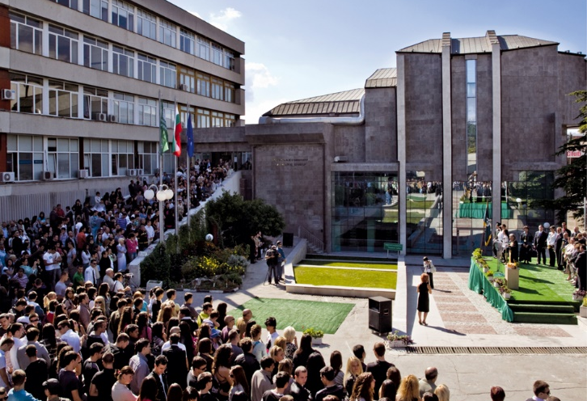
30 academic years
Highest accreditation rating among private universities
in Bulgaria
9.21 (on ten-point scale)
9.21
Highest student evaluation of teaching quality
Excellent 5.63 (on six-point scale)
The first university in Bulgaria holding the prestigious signs ECTS Label, DS Label and HR Logo awarded by the Executive Agency for Education and Culture of the European Commission
Magna Carta Universitatum, the Great Charter for Academic Freedom and Independence signed in 2007 and 2021
The only university in Bulgaria with a 22-year continuous cycle of quality management system according to ISO 9001:2015 standard
VarnaFreeUniversity www.vfu.bg

Slide 4
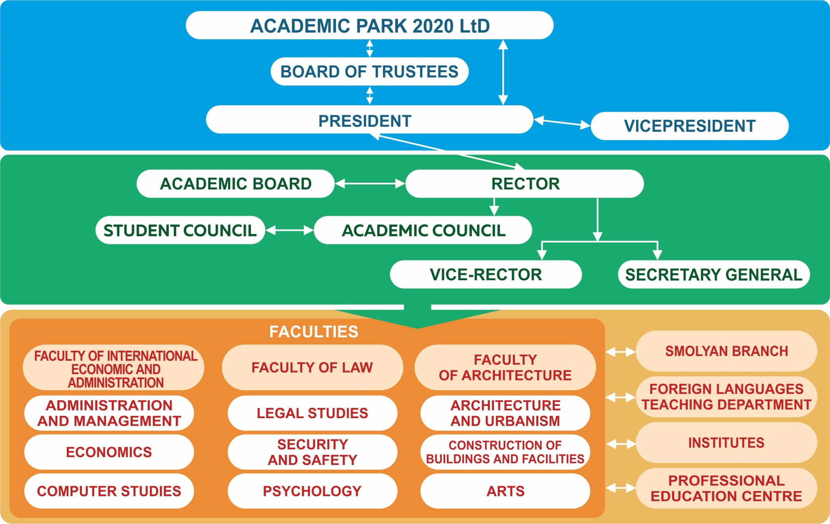
University structure

Slide 5
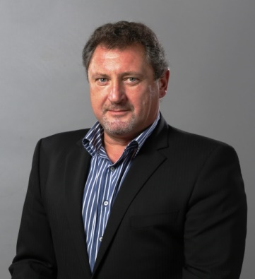
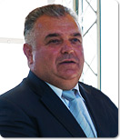
University Management
Prof. D. Sc. Anna Nedyalkova
Chairperson of the Board of Trustees
Prof. Petar Hristov, PhD
Rector
Assoc. Prof. Krasimir Nedyalkov, PhD
President
Prof. Dimitar Kanev, D.Sc.
Vice-rector
Yani Yanev
Vice President
Prof. Galina Shamonina, PhD
Secretary General

Slide 6
Academic Family
4 000
students
20
Bachelor’s degree programmes
49
Master’s degree programmes
29
Doctoral programmes
VarnaFreeUniversity www.vfu.bg

Slide 7
Faculty of International Economics and Administration
Business Administration and Management
International Business in English
International Economic Relations
Finance and Accounting
Informatics and Computer Science
VarnaFreeUniversity www.vfu.bg

Slide 8
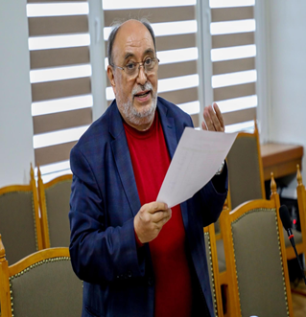
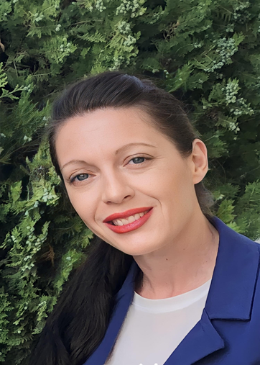
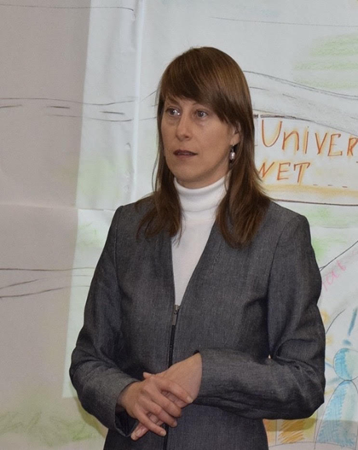
Department of Economics
Political economy
World economy and international economic relations
Accounting, control and analysis of economic activity
Financial and banking management and marketing
Accounting and financial statements
Financial audit
Tax and customs control
International Economic Relations
Finance and Accounting
International Finance
(in English)
International Business
(in English)
Ph.D.
Master's degree
Bachelor's degree
Doctor of Science degree
FINANCIAL LITERACY FOR THE ECONOMIC DEVELOPMENT OF SOCIETY
№2022-1-BG01-KA220-SCH-000087865
Key Action 2: Cooperation among organisations and institutions
KA220-SCH - Cooperation partnerships in school education
Professor
Emil Panusheff, Ph.D.
project manager
researcher
Head assistant Sevgi Osman, Ph.D.
project coordinator
researcher
Associate Professor
Virginia Ivanova, Ph.D.
researcher
Head assistant
Miglena Pencheva, Ph.D. researcher
Kremena Hubcheva Radosstina Ivanova
Technical contractor Accountant

Slide 9
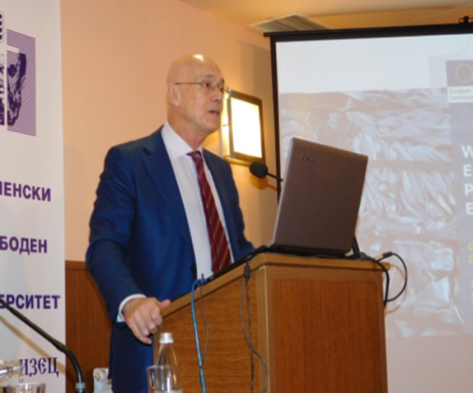
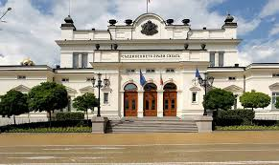
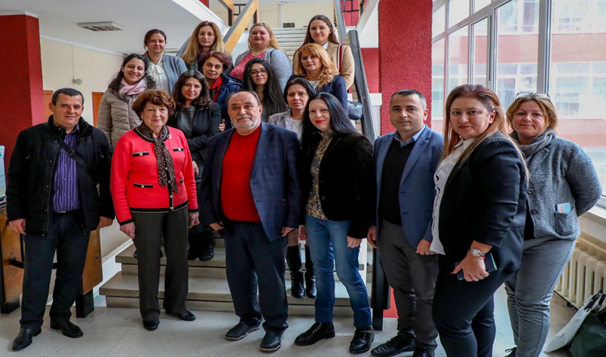
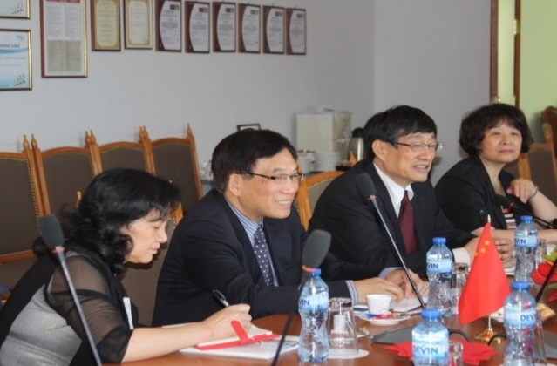
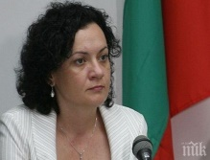
Master’s degree programme in
Circular Economy
circulareconomy.vfu.bg
VFU in partnership with
Varna Municipality
VarnaFreeUniversity www.vfu.bg

Slide 10
Master’s degree programme in Entrepreneurship
entr.vfu.bg
VFU in partnership with
VarnaFreeUniversity www.vfu.bg

Slide 11
Faculty of Law
Law
Psychology
National Security
Counteraction to Crime and Public Order Protection
VarnaFreeUniversity www.vfu.bg

Slide 12
Faculty of Architecture
Construction of Buildings and Facilities
Interior and Graphic Design
Fashion Design
Architecture
Choreography
VarnaFreeUniversity www.vfu.bg

Slide 13
Strategy for development of VFU "Chernorizets Hrabar"
Sustainability
Changing the educational model
Ensuring the sustainability of the system by developing adequate, internationally convertible academic capacity, purposefully providing the necessary resources and project management
08
01
A competency - based model that traditionally combines with virtual training
Scientific research
Balanced management
02
Improving the share and quality of research; Joining the European Research Area, networking and clustering
Management based on the balance between market - product - capacity - economic and social result
07
PRIORITIES
Academic potential
Market approach
03
06
Consolidation and capacity building for the implementation of the new educational model and creation of an innovative ecosystem
Focus on making and stimulating markets
Partnership
05
04
Creating a high-tech environment
Creating a favorable environment for public-private partnership and cooperation between educational, scientific and economic activities
Based on world scientific achievements and application of modern ICT and digital technologies
VarnaFreeUniversity www.vfu.bg

Slide 14
Strategy for development of VFU "Chernorizets Hrabar"
Digital education For the industry, management and the social sphere
CIRCULAR ECONOMY
Environment Directorate General of the European Commission, Ministry of the Environment and Water
and universities from China
1
Network and leading technology companies
3
2
4
INNOVATION AND ENTREPRENEURSHIP
CYBERSecurity AND Intelligent systems for Protection of the population
Mentors and experts from Silicon Valley in the USA
Leading experts and companies from Europe, Israel and China
VarnaFreeUniversity 052 355 106 priem@vfu.bg www.vfu.bg
Notes:
© Copyright Showeet.com – Creative & Free PowerPoint Templates

Slide 15
Internationalization Areas of Partnership
Joint educational programmes allowing for two diplomas to be awarded, exchange of teaching teams; mobility, recognition of diplomas
Developing a network for exchange of good practices, training and research between partners
Institute for Digital Education
Internships and practices
Joint laboratories
Joint infrastructure investments
Summer schools and short-term courses
VarnaFreeUniversity www.vfu.bg

Slide 16
Thank you for your attention!
www.vfu.bg

