Slide 1
FINANCIAL LITERACY FOR A BETTER DEMOCRACY
Elsa Fornero
November 13th, 2023 – Torino

Slide 2
SUMMARY
The importance of financial literacy
What is «financial literacy»?
A prolific field of research
Micro, macro and political level
Financial literacy and individual life cycle
Intertemporal decisions
Youth (education, NEETs)
Adulthood (investments, debt)
Old age (retirement, private schemes)
Gender gap and inequalities
Financial literacy and democratic choices
Financial market deepening
Citizenship and electoral participation
FinLit as a “relational” good

Slide 3
WHAT IS «FINANCIAL LITERACY»?
The OECD INFE has defined financial literacy as follows:
A combination of
awareness, knowledge, skill, attitude and behavior
necessary to make sound financial decisions
and ultimately achieve individual financial wellbeing
….. a broad and demanding goal

Slide 4
A DISTINCT ACADEMIC FIELD OF STUDY
Journal of Economic Literature code: G53
Connects top scholars around the world to facilitate the exchange of ideas, promote evidence-based research and meet the growing urgency for data-driven solutions
The network: (G)53 researchers dedicated to produce high-quality, rigorous research on FinLit, FinEdu, personal finance and related topics
Why now
Increasingly recognized importance and exponential growth over the last decades
Embraced by international institutions and governments worldwide (national committees)
Empirically, the need for basic financial knowledge has never been greater. The new global challenges - i.e. the Great Recession, COVID-19 pandemic, wars, inflation - demand joint effort to inform policy and programs, and to find ways to empower people to achieve better life outcomes

Slide 5
A PROLIFIC FIELD OF RESEARCH
In the last couple of decades, FinLit has been defined, measured, analyzed, and correlated to:
individual decisions and behaviours, from saving to portfolio choices; from retiriment planning to participation to pension funds; from investment in human capital to debt management (Lusardi and Mitchel, 2014; Fornero and Monticone, 2011)
the distribution of human capital and of material/financial wealth: FinLit explains a significant share of inequality in the US (Lusardi, Michaud and Mitchel, 2017)
voting behaviour: the electoral cost of a pension reform is significantly lower in countries with higher FinLit (Fornero and Lo Prete, 2018)
quantity and quality of media information (Fornero, Oggero and Puglisi, 2018)

Slide 6
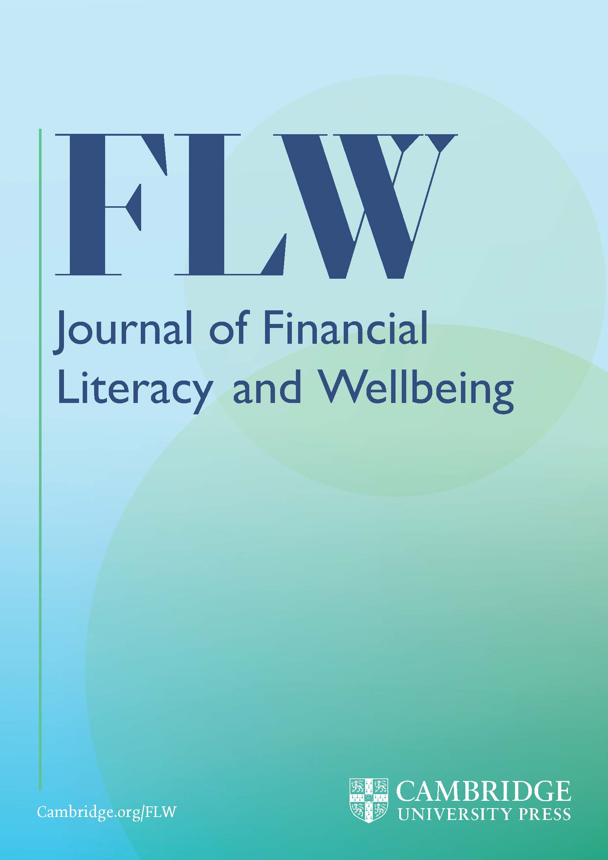
A PROLIFIC FIELD OF RESEARCH
Creating programs: since FinLit can be improved by investing in education, governments may increase citizens’ awareness of what is involved in both personal finance management and in economic policy and reforms, by investing in specific education programs for adults and basic financial education in school, helping to improve the outcomes of individual and collective decisions.
Testing programs: the effectiveness of specific programs of financial education, ad hoc for more exposed groups or as part of general education in school, have been assessed (Martin, 2012; Nicolini and Cude, 2022)
Fornero, E., & Lo Prete, A. (2023, Financial education: From better personal finance to improved citizenship. Journal of Financial Literacy and Wellbeing

Slide 7
THE IMPORTANCE OF FINANCIAL LITERACY
Micro level
Macro level
Political
level

Slide 8
THE IMPORTANCE OF FINANCIAL LITERACY
Personal finance: highly relevant to essential choices in various aspects/moments of the individuals’ life cycle, from youth to seniority
Equality: reduce income and wealth inequality, promote policy measures (e.g. a more progressive and universal taxation)
Citizenship: understanding of economic reforms needed to improve efficiency, inclusion, and sustainability of public finances and institutions
Economic gains and losses (fragility, exclusion..) in a risky environment
A common basis to improve society

Slide 9
KEY ECONOMIC DECISIONS OVER THE LIFE CYCLE
Greater responsibility transferred onto individuals, in consequence: greater complexity of life in a globalized world, pro-market policies of past decades, financial markets deregulation and the cutback of public welfare programs.
Myopic behavior
Irrational decisions
Lack of information and/or knowledge of economic concepts needed to make well-informed financial decisions
Intertemporal dimension
Immediate or short-term sacrifice (benefit) against an expected gain (loss) in the future
vs.

Slide 10
KEY ECONOMIC DECISIONS OVER THE LIFE CYCLE
Modigliani and Brumberg, The Life Cycle Hypothesis of Saving (1954)
Friedman, Permanent Income Hypothesis (1957)
YOUTH
ADULTHOOD
SENIORITY

Slide 11
A SPECIFIC PROBLEM: GENDER GAP AND INEQUALITIES
FinLit gap: women - of all ages, in almost all countries - are less literate than men. This gap persists even after accounting for different psychological traits in men/women (e.g. documented women’s greater risk aversion and lower self-confidence, which typically lead women to more prudent – and less profitable – portfolio choices)
Stereotypes: differences in educational paths; earlier, modeling preferences and attitudes and, later, skills and opportunities; emphasis on “masculine” language, entertainments and toys for boys and “feminine” versions for girls; incentives toward different school subjects; subtle linguistic biases (Boggio et al, 2018)
Women’s empowerment: according to UN Women
Women’s economic empowerment is central to realizing women’s rights and gender equality. Women’s economic empowerment includes women’s ability to participate equally in existing markets; their access to and control over productive resources, access to decent work, control over their own time, lives and bodies; and increased voice, agency and meaningful participation in economic decision-making at all levels from the household to international institutions

Slide 12
THE YOUNG AND EARLY ADULTS
Investing in human capital requires comparing (expected) rate of return with the return forgone on an alternative use of the resources needed to finance education or with the rate of interest paid on the loan obtained
Young borrowers may not:
be fully aware of potential risks of the diverse alternatives
figure out the future monthly re-payments and have serious problems in managing the debt
complete the education for which they borrowed money
On the work side, where the Great Recession and subsequent crises caused an expansion of precarious jobs and self-employment, low levels of fin. literacy are more likely to be associated with:
poorer employment opportunities, outcomes and incomes
a higher probability of postponing independence and continue to live with their parents
lower participation to pension schemes
lower awareness of the correlation between contributions and pension benefits, particularly with DC pension formulae

Slide 13
NEETs (Not in Employment, Education, Training)
Average: 13.1% in the age group 16-29 - from 5.5% in the Netherlands to 23.1% in Italy (2021)
Problem exacerbated by the “social distance” imposed by COVID-19
Inadequate education
Marginalization within society
More likely to be unable to deal with public offices, access emergency funds
More likely to lack financial understanding (open a bank account,
pay household bills,
compare credit)

Slide 14
FinLit IN SCHOOLS
PISA survey: since 2012, OECD introduced a module to measure financial literacy among 15-year-old students (latest data: 2018)
around one in four students is unable to make simple “knowledgeable” decisions about everyday expenditure
boys scored higher than girls
more top-performing boys than top-performing girls (probably because of lower attendance to financial education programs and fewer experiences with digital financial transactions)
The gender gap is very relevant because it is likely to persist throughout life, contributing to women’s financial vulnerability as a group
Basic financial education to children helps them to acquire planning capabilities and to develop good financial behavior.
Good habits may also come from practices, like opening children a bank account (OECD, 2014) or providing them with pocket money (Sansone et al., 2019) or from games (see ANGLE project)

Slide 15
ADULTHOOD AND SAVING/INVESTMENT DECISIONS
Gender gap and lack of self-confidence: women are less likely than men to answer correctly and more likely to indicate “do not know” as an answer;
Rent or buy a house: nominal vs real rate of interest; compound interest (gross and net of expenses, fix or variable); basic notions of wealth (il)liquidity; mortgages, instalments.
Portfolio decisions: financial literacy positively associated to investments in the stock market and to benefits from the equity premium
Debt management: lower literate people tend to use credit cards in expensive ways and to borrow at higher rates; to use nonorthodox or illegal financial services such as payday loans/pawnshops; to be less familiar with insurance and express a lower demand for its products (particularly life insurance);

Slide 16
THE OLD AND RETIREMENT OUTCOMES
State intervention: making retirement saving compulsory and also by directly running the pension system
BUT public pensions may be insufficient to maintain the previous standard of living
Private pension schemes imply more decisions:
enrollment, normally voluntary
how much to contribute
whether to borrow from retirement funds and, if so, when and how much to repay
portfolio choice and its changes as retirement approaches
age of retirement
characteristics of the ensuing annuity (i.e. a survivor pension and/or an indexation mechanism)
Being able to develop and implement retirement plans is key to retirement security

Slide 17
WEALTH AT RETIREMENT
30-40% of wealth inequality at retirement can be explained by financial knowledge (Lusardi 2017)
In the U.S., the most financially savvy are more likely to participate in and contribute the most to their saving plan (Clark et al., 2017)
U-shaped relationship between age and the quality of decision-making in several financial areas (Agarwal et al., 2019)
In Italy, financial literate are more likely to save for retirement and to save through a private pension plan (Fornero & Monticone, 2011)
Women’s retirement: disadvantages/discriminations in labor market participation, career progression (the ‘glass ceiling’) and earnings
→ disadvantages in pension accruals and entitlements
Subtler disparities in pension rules (i.e. eligibility conditions, retirement ages, and the specific formulae to calculate benefits) sometimes explicitly and paternalistically favor women, with the aim of providing an ex-post compensation for ex-ante discrimination

Slide 18
FINANCIAL LITERACY AND CITIZENSHIP
Civic engagement: a democracy needs citizens’ participation and engagement in a process that involves both institutions and voters
Voter turnout (= the percentage of eligible voters who show up at polls): as a proxy of civic engagement, people with more education are more likely to participate in political life (Dee, 2004; Tenn, 2007) + Electoral participation is higher in countries where more people are financially literate (Lo Prete 2021)
Political advantages of financial literacy:
higher probability of a government to be re-elected in the aftermath of an economic reform (Fornero, Lo Prete, 2019)
reduce the scope of manipulation of voters’ beliefs by governments who use excessive deficits to win the elections (Murtinu et al., 2017),
willingness to support a pension reform (Fontoura Gouveia, 2017)
redistributive policies (Montagnoli et al., 2017)

Slide 19
A «RELATIONAL» GOOD
From rational to relational: human beings are interconnected by economic, social and political exchanges, which normally take place in markets that are far from perfect and all embracing. These interrelations influence their personal choices by modelling/stimulating their preferences and thus their perceived optimal behaviour.
Individuals’ wellbeing Social wellbeing
Common goods: even if social justice, inter-generational fairness are not necessarily part of individuals’ guiding principles, they are not extraneous to individuals’ reactions to policies and should at least be considered as co-determinants of collective decisions, important to all
→ FinLit is not just a private asset but it is a “relational good” contributing to the formation of the majority consensus which is necessary to decide on the desired provision of “common goods”

Slide 20
Links
Linee guida per la financial literacy (link)
“OCSE PISA 2018 Financial Literacy: I risultati degli studenti italiani” (link)
“PISA 2018 Results: Are students smart about money?” (link)
Portale “Quello che conta” (link)
“Improving youth financial literacy through games” (link)
Sito progetto ANGLE (link)
Sito progetto FinKit (link)

