Slide 1


FINANCIAL LITERACY
FOR THE ECONOMIC DEVELOPMENT OF SOCIETY
№ 2022-1-BG01-KA220-SCH-000087865
Key Action 2: Cooperation among organisations and institutions
KA220-SCH - Cooperation partnerships in school education
Prof. Emil Panusheff, PhD
Turin, Italy, 13-15 November 2023

Slide 2
Main highlights
Why to brainchild a project on Financial Literacy
What is the general meaning of this topic
What are the objectives and goals
What are the expected results
Which are the use of the project results as sustainability activities for the partners and for the EU

Slide 3
Why to brainchild a project on Financial Literacy the importance of acquiring financial literacy skills will only grow in the future
First
Financial education will have a role, in conjunction with financial consumer protection and regulations, in equipping people with the skills needed to understand more complex products and services, choose those most appropriate for them, and protect themselves from financial scams.
Technology (e.g. investment simulators or budgeting apps) has the potential to facilitate financial decisions and calculations; but here too financial education can help ensure that citizens understand how to use such tools responsibly.
The spread of digital financial services may open up new opportunities for those who are excluded from the formal financial system to gain access to it; but those services can also expose consumers to new security threats and risks of fraud that are compounded when low financial literacy is combined with poor digital skills and limited awareness of cybersecurity.
The increasing availability of online credit, hidden fees associated with various service providers (such as mobile phone plans) and in-game or in-app purchases, which are often targeted to young and/or inexperienced consumers, will pose further challenges for financial consumer protection and education.

Slide 4
the importance of acquiring financial literacy skills will only grow in the future
Second
In some countries, future generations will probably bear more financial risks during their lifetime than the current adult population, due to factors such as increased life expectancy, less welfare protection and more uncertainty in retirement income due to changing pension regimes.
Variable employment prospects and the potential for economic instability as a result of digitalisation, technological change, climate change, pandemics, globalisation and changes in the nature of work may also contribute to financial uncertainty.

Slide 5
the importance of acquiring financial literacy skills will only grow in the future
Third
Growing income and wealth inequality might mean that without strong financial literacy, socio-economically disadvantaged groups could fall further behind.
Education, income and wealth have been shown to be strongly correlated with adults’ financial knowledge, and parents with less education, income or wealth have been found to be less well-equipped than other parents to transmit financial knowledge to their children.
Only parents who educate their children about money matters, inequalities not just in levels of financial literacy but also in wealth and financial well-being may be reinforced across generations.
Providing youth with financial education in schools and via other programmes might help shrink disparities in financial literacy due to differences in students’ current socio-economic status, and potentially reduce income and wealth inequality when these students become adults.

Slide 6
general meaning of Financial Literacy
Definition
A combination of awareness, knowledge, skill, attitude and behaviour necessary to make sound financial decisions and ultimately achieve individual financial wellbeing.

Slide 8
Age categories

Slide 9
Money and transactions

Slide 10
Planning and managing finances

Slide 11
Risk and reward

Slide 12
Financial landscape

Slide 14
Project objectives
To ensure the development of financial literacy skills of students at an early age
Developing a financial literacy curriculum that can be used at middle school level
Developing content for the curriculum, determining teaching methods and techniques
Creating a digital content for documents and studies related to financial education
Developing teachers' financial literacy skills
To create awareness of saving and spending in individuals

Slide 15
Project goals
Defining the framework of the financial competences of students of the target group
Developing a financial literacy curriculum for students from a young age
Determining the appropriate teaching methods and techniques to achieve the defined competencies
Defining approaches to teaching financial literacy to teachers.
Creating a digital portal with financial literacy content for teachers and students
Development of approaches to integrate financial literacy training into education in view of the economic development of society (ecological understanding, green transition, circular economy)

Slide 16
The expected results
In this project, a Financial Literacy curriculum will be prepared to be taught at middle school level by experts within our partnership.
Financial literacy contents for the curriculum will be prepared and turned into a digital book.
A digital portal will be created where students and teachers can access financial content and make financial transactions.
Financial literacy will be integrated into education in the long run.

Slide 17
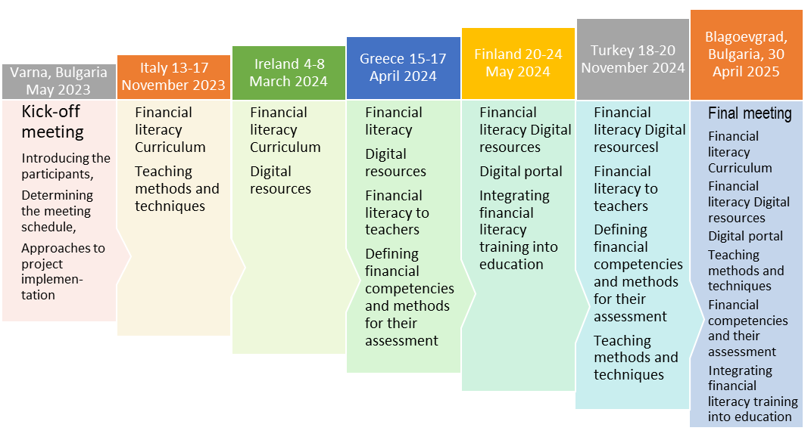
Project development

Slide 18

Financial Literacy Proposal
CURRICULUM
Introduction to Financial Literacy
Money and Currencies
Purchases and Payments
Consumer Protection
Managing and Planning Income and Expenditure
Budgeting and Saving
Education and Investing
Identifying Risk and Reward
Scams and Fraud
Tax and public spending

Slide 19
The use of the project results as sustainability activities for the partners and for the EU
The achievements of the project will be used to teach children and young people about financial literacy. The projects outcomes will be a tool for preparing financial literacy lessons, curricula, and programs. It could be used to:
support the development, implementation, and revision of national financial literacy strategies, which often include young people in their primary target audience.
support the integration of financial literacy into school curricula and vocational training.
support the development of specific financial literacy programs and learning materials for children and young people to be implemented in schools and elsewhere.
The success of the project will meet the willingness of partners and EU Member States to use it, thereby helping to increase the effectiveness of financial literacy policies and initiatives.

Slide 20


Contribution of the project to EU policies
FINANCIAL LITERACY
Towards a green, digital and resilient economy
European Union/OECD (2023), Financial competence framework for children and youth in the European Union
European Union/OECD (2022), Financial competence framework for adults in the European Union
Digital Single Market
Banking Union
Sustainable Finance
The European Green Deal
European Financial Stability and Integration

Slide 21

Thank you for your attention!
Grazie per l'attenzione!
www.vfu.bg
emil.panusheff@vfu.bg

